Slide 1
Sprint 1 Status Update
GMU OFFICE OF THE PROVOST, ENROLLMENT MANAGEMENT
Team Prophecy
Week # 3
02/13/2023

Slide 2
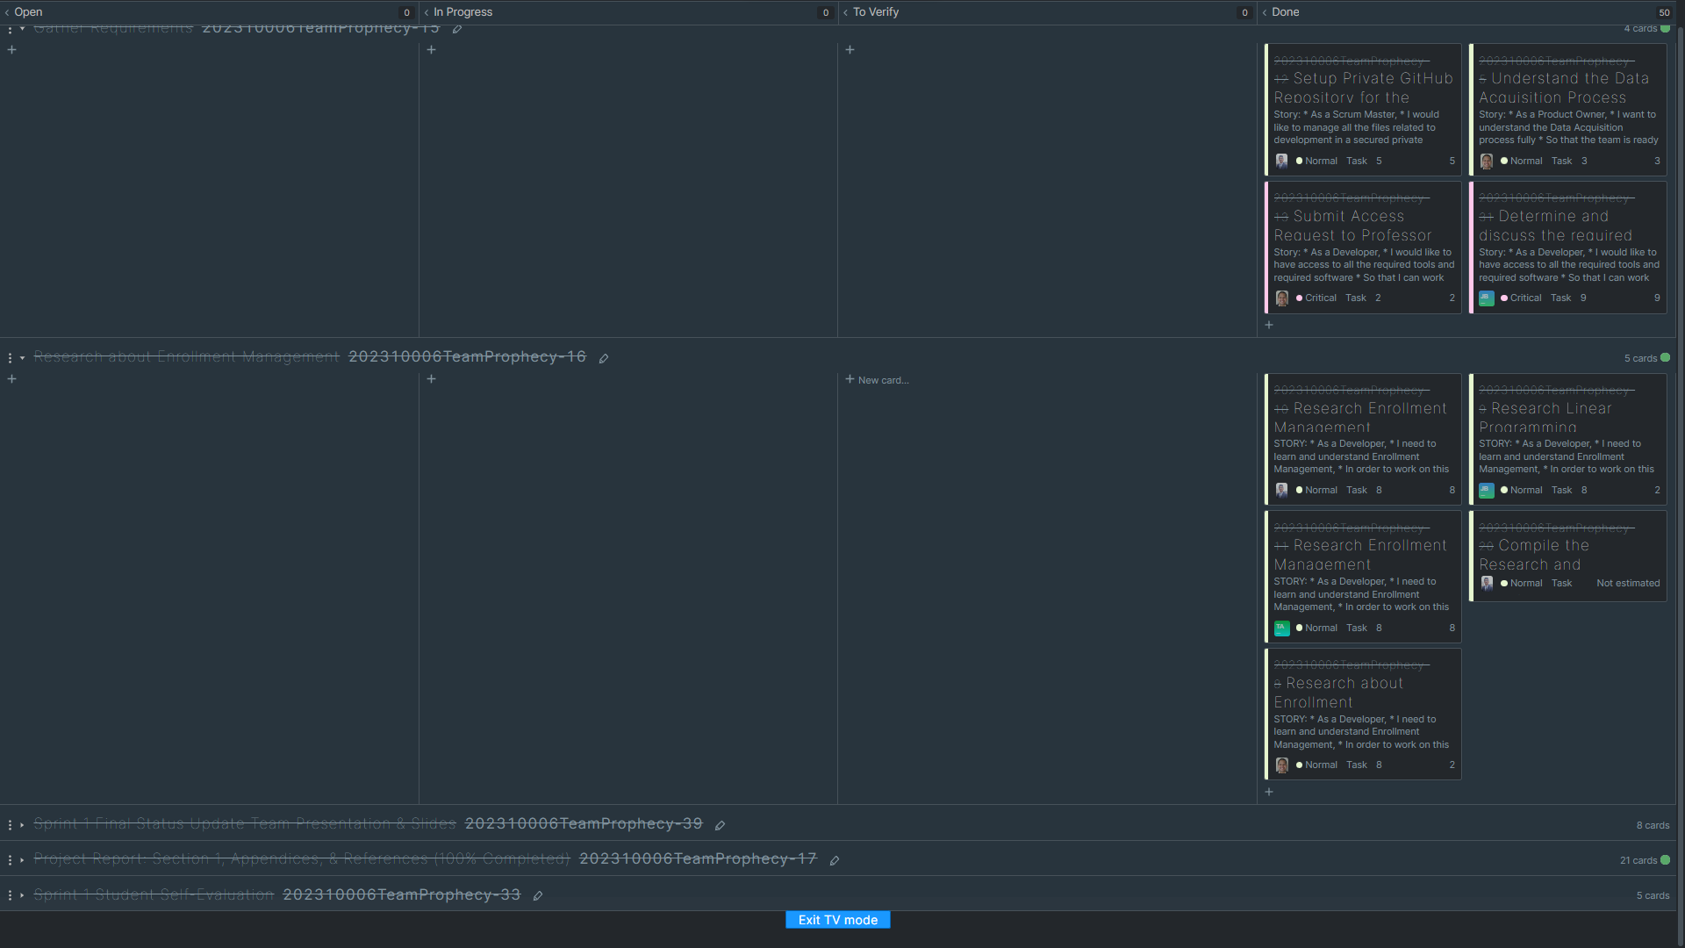
YouTrack
Instructions: SCRUM Master will bring up YouTrack Project page and show Sprint 1 Board
Work with instructor prior to mid-sprint-1 presentation to define all user stories and tasks
All user stories must have a description, exit criteria, assigned to team member, and priority
All user story associated tasks must a description, exit criteria, assigned to team member, and priority
SCRUM Master will be responsible for placing task in the “In Progress” column when ready;
Assigned team member to task is responsible for placing comments and attachment in the task; this will be reviewed by the team member assigned to verify the task and instructor; part of sprint grade
Assigned team member to task moves task to “To Verify” column with task is complete assigns team member to verify the task
Assigned team member to verify task will review the task and either move it to “Done” column if it satisfies exit criteria or moves it back to “In Progress” column with comments why if failed and reassigns to previous task assignee

Slide 3
team Members
Telina Andrianaivo
Scrum Master
Sagar Goswami
Developer
Erick A Torres
Product Owner
Darvik Kunal Banda
Developer
Joe B Brock
Developer

Slide 4
problem statement
Problem Context:
Domain of problem:
  The Office of Provost is negatively affected by waitlisted students unable to get to the classes that they desire. This creates a competitive environment where students must fight to get the classes that they need to graduate.
Importance of problem:
  Students who are unable to enroll in their planned courses will join waitlists and may risk deferring their graduation. For International students, they will have to settle for other courses in order to not risk losing their visa status. These issues will require the college to reevaluate their allocation of resources in order to address the amount of students on a waitlist.
Problem Statement:
The College of Engineering and Computing is experiencing rapid growth that is leading to more students joining waitlists for full courses. The waitlists are continuing to grow with each semester.

Slide 5
Datasets
Proposed Datasets for Project [for each dataset]
Dataset Name:
  The Office of Provost is the dataset owner for CEC data. Any proprietary data provided to us will be utilized in a CSV file, but the data size is unknown. The team has received approval that some data can be scrapped from the CEC website.

Slide 6
Potential Analytics/algorithms
Analytic/Algorithm Name: Linear Programming, CART/Random Forest, Regression Models, Time-Series/ARIMA, Deep Learning
Datasets: Course Enrollment Activity
Computer Resources Required: AWS Cloud Service Platform, Network File Sharing System (EFS/FsX) to stem to EC2 instances
Training: Our training set will be divided into partitions based on the snapshot CSVs provided by Microstrategy
Optimization: Constraints will be utilized to help with the optimization process of our Linear Programming/Stochastic Optimization models
Testing: Our testing set will retrieve any recent data that is not currently used, likely through the latest snapshot CSV provided by Microstrategy

Slide 7
Potential Analytics/algorithms
Classification and Regression Trees (CART)
Random Forest
Regression Models
Data
Optimization Models / Linear Programming
Student Enrollment Data
Machine Learning
Course Catalog Data
Data Management
Data Wrangling
Data Storage
Feature Extraction
Data Exploration
Correlation Checks
Distributions
Bias
Model Optimizations
Analytics
Combination Techniques
Classification Models

Slide 8
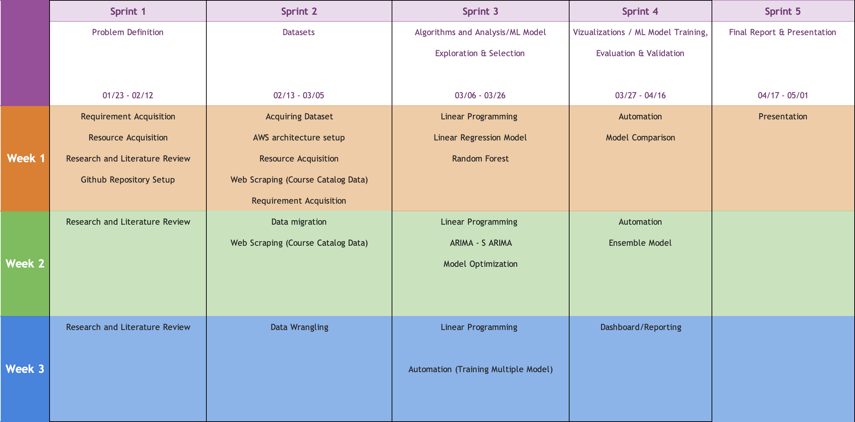
Project Schedule

Slide 9
Risks and Planned Mitigations
Risk Name | Description | Probability | Impact | Mitigation
Miscommunication | The team gets confused as to what is expected. | Medium | High | Encourage YouTrack to be checked and updated daily.
Task Management | The large number of tasks can be overwhelming. | Medium | Medium | Organize YouTrack to provide more guidance on tasks to be completed.
Scheduling Issues | It is a challenge to get everyone together at one time. | High | Medium | Encourage independent work and communicate work being completed

Slide 10
Weekly Partner Meeting
Daniel Fisher is our Primary Partner POC
Team Progress from Prior Week
  We started out going over the problem statement and getting feedback from our Project Partners.
  There was more clarity provided as to how the process of deciding which courses are offered and how many sections.
  More background was shared into how our Project Partners have attempted to address the problem.
  Learned that the waitlist will never go away, the amount needs to be addressed.
Team Tasks for Current Week
  Review and analyze the dataset.
  Refine ideas from our research of how to best address the problem.
  Begin the Sprint 2 section of the written report.
  Keep YouTrack updated so we know what is expected.
Other Items Discussed
  We discussed financial impacts of waitlists.

Slide 11
Sprint 2 Status Update
Datasets
Team Name
Week #
Date

Slide 12
YouTrack
Instructions: SCRUM Master will bring up youTrack Project page and show Sprint 2 Board
Work with instructor prior to mid-sprint-2 presentation to define all user stories and tasks
All user stories must have a description, exit criteria, assigned to team member, and priority
All user story associated tasks must a description, exit criteria, assigned to team member, and priority
SCRUM Master will be responsible for placing task in the “In Progress” column when ready;
Assigned team member to task is responsible for placing comments and attachment in the task; this will be reviewed by the team member assigned to verify the task and instructor; part of sprint grade
Assigned team member to task moves task to “To Verify” column with task is complete assigns team member to verify the task
Assigned team member to verify task will review the task and either move it to “Done” column if it satisfies exit criteria or moves it back to “In Progress” column with comments why if failed and reassigns to previous task assignee

Slide 13
Datasets
Datasets Planned for Project [for each dataset]
Dataset Name:
  Extraction in Progress, but this is what we know…
  Dataset Owner: Enrollment Management
  Dataset Type: Proprietary
  Dataset Size: Unknown
  Dataset License: Unknown, we haven’t gotten any information relating to this
  Dataset Location: Banner (storage)
  Dataset Access: Unknown
  Dataset Restrictions: Contains PII which is expected to be scraped
  Dataset Time Range: Time range from 5 years back (2018-2023)
  Dataset Collection Process: A CSV will be provided, but HTML scrapping will be allowed.
  Analytic/Algorithm that will use dataset: ARIMA, Linear Programming, Linear Regression

Slide 14
Dataset Quality – [dataset name]
Dataset - :
Completeness–requires that a particular column, element, or class of data is populated and does not feature null values or values in place of nulls (e.g., N/A).
Consistency–something that tests weather one fact is consistent with another.
Uniqueness–are all the entities or attributes within a dataset unique?•Integrity–are all the relationships populated for a particular entity? [e.g., the inability to link related records together may introduce duplication across systems]
Conformity–does the data conform to right conventions and standards?
Accuracy–refers to whether the data values stored for an object are the correct values. To be correct, a data values must be the right value and must be represented in a consistent and unambiguous form. For example, my birth date is December 13, 1941

Slide 15
Risks and Planned Mitigations
Risk Name | Description | Probability | Impact | Mitigation
Miscommunication | The team gets confused as to what is expected. | Medium | High | Encourage YouTrack to be checked and updated daily
Task Management | The large amount of tasks can be overwhelming. | Medium | Medium | Organized YouTrack to provide more guidance on tasks to be completed.
Lack of Research | Hard to find research related to our topic | Medium | Medium | Find other ways of completing our research of prior studies.
Scheduling Issues | It is a challenge to get everyone together at one time. | High | Medium | Encourage independent work and communicate work being completed.

Slide 16
Weekly Partner Meeting
Daniel Fisher is our Primary Partner POC
Team Progress from Prior Week
  The Team has progressed immensely with the Report from last week. There was more context provided by our point of contact regarding what we were doing. Further, the professor gave us insight as to considered useful tools and positive feedback on the models that we were intending to use. A Data Catalog will be issued to us to prep us for the next sprint.
Team Tasks for Current Week
  The current tasks is to finish up the planning phase for our project. The scope of the problem statement appears to be defined, but it would help to have further insight into what’s going on. Pre-Requisite classes and Core Classes are likely to be primary targets of focus for handling waitlisting issues.
Other Items Discussed
  There is likely going to be some form of storage system that can trigger an analysis on any CSV data provided.

Slide 17
Sprint 3 Status Update
Algorithms & Analysis / ML Model Exploration & Selection
Team Name
Week #
Date

Slide 18
YouTrack
Instructions: SCRUM Master will bring up youTrack Project page and show Sprint 3 Board
Work with instructor prior to mid-sprint-3 presentation to define all user stories and tasks
All user stories must have a description, exit criteria, assigned to team member, and priority
All user story associated tasks must a description, exit criteria, assigned to team member, and priority
SCRUM Master will be responsible for placing task in the “In Progress” column when ready;
Assigned team member to task is responsible for placing comments and attachment in the task; this will be reviewed by the team member assigned to verify the task and instructor; part of sprint grade
Assigned team member to task moves task to “To Verify” column with task is complete assigns team member to verify the task
Assigned team member to verify task will review the task and either move it to “Done” column if it satisfies exit criteria or moves it back to “In Progress” column with comments why if failed and reassigns to previous task assignee

Slide 19
analytic/algorithm Specification
Name:
How it works: [brief description on the “inner workings of algorithm”
Data Inputs: [include description of data input requirements and any data preparation required, size of input data, data types such as training, testing, etc., e.g., conditioning, transformation, formats, etc.)
Data Outputs: [include description on the data output; how will output data be used]
Hyperparameters:
Model Tuning:
Model Training Resources Required: [CPU, GPU, cloud based, laptop, memory, etc.]
Model Deployment: [how will the trained model be used]

Slide 20
analytics/algorithms - Demonstrations
[provide a demo for each analytic/algorithm be considered]

Slide 21
Risks and Planned Mitigations
Risk Name | Description | Probability | Impact | Mitigation
[meaningful] | [brief] | [high, medium, low] | [high, medium, low] | [brief]

Slide 22
Weekly Partner Meeting
Partner name [Primary Partner POC]
Team Progress from Prior Week
Team Tasks for Current Week
Other Items Discussed
Instructions: Each week the team is expected to meet with their project partner. The project team is expected to take copious notes of the meeting and what was discussed – just as would take place in any consulting services client meeting engagement.
The first partner meeting will be primarily a Q & A session between the partner and the team – with the team asking detailed and probing questions regarding the problem statement and any specialized subject matter knowledge the partner has relative to the problem domain.
Thereafter, project teams should be reporting on three things each week:
Team Progress from Prior Week
Team Tasks for Current Week
Other Items Discussed
This slide summarizes for the rest of the class what the project team presented to the partner – as well as any other items discussed during the meeting.

Slide 23
Sprint 4 Status Update
Visualizations / ML Model Training, Evaluation, & Verification
Team Name
Week #
Date

Slide 24
YouTrack
Instructions: SCRUM Master will bring up youTrack Project page and show Sprint 4 Board
Work with instructor prior to mid-sprint-4 presentation to define all user stories and tasks
All user stories must have a description, exit criteria, assigned to team member, and priority
All user story associated tasks must a description, exit criteria, assigned to team member, and priority
SCRUM Master will be responsible for placing task in the “In Progress” column when ready;
Assigned team member to task is responsible for placing comments and attachment in the task; this will be reviewed by the team member assigned to verify the task and instructor; part of sprint grade
Assigned team member to task moves task to “To Verify” column with task is complete assigns team member to verify the task
Assigned team member to verify task will review the task and either move it to “Done” column if it satisfies exit criteria or moves it back to “In Progress” column with comments why if failed and reassigns to previous task assignee

Slide 25
Visualizations
[provide a series of visualizations for results based on sprint 3 work; these visualization should provide the audience with insights into your findings that will support your problem solution; it is important to discuss findings that are incorrect or not useful and findings that support the problem solution]

Slide 26
Risks and Planned Mitigations
Risk Name | Description | Probability | Impact | Mitigation
[meaningful] | [brief] | [high, medium, low] | [high, medium, low] | [brief]

Slide 27
Weekly Partner Meeting Update
Partner name [Primary Partner POC]
Team Progress from Prior Week
Team Tasks for Current Week
Other Items Discussed
Instructions: Each week the team is expected to meet with their project partner. The project team is expected to take copious notes of the meeting and what was discussed – just as would take place in any consulting services client meeting engagement.
The first partner meeting will be primarily a Q & A session between the partner and the team – with the team asking detailed and probing questions regarding the problem statement and any specialized subject matter knowledge the partner has relative to the problem domain.
Thereafter, project teams should be reporting on three things each week:
Team Progress from Prior Week
Team Tasks for Current Week
Other Items Discussed
This slide summarizes for the rest of the class what the project team presented to the partner – as well as any other items discussed during the meeting.

Slide 28
Sprint 5 Status Update
Final Report & Showcase Presentation Preparation
Team Name
Week #
Date

Slide 29
Team Name — YouTrack
Instructions: SCRUM Master will bring up youTrack Project page and show Sprint 5 Board
Work with instructor prior to mid-sprint-5 presentation to define all user stories and tasks
All user stories must have a description, exit criteria, assigned to team member, and priority
All user story associated tasks must a description, exit criteria, assigned to team member, and priority
SCRUM Master will be responsible for placing task in the “In Progress” column when ready;
Assigned team member to task is responsible for placing comments and attachment in the task; this will be reviewed by the team member assigned to verify the task and instructor; part of sprint grade
Assigned team member to task moves task to “To Verify” column with task is complete assigns team member to verify the task
Assigned team member to verify task will review the task and either move it to “Done” column if it satisfies exit criteria or moves it back to “In Progress” column with comments why if failed and reassigns to previous task assignee

Slide 30
Risks and Planned Mitigations
Risk Name | Description | Probability | Impact | Mitigation
[meaningful] | [brief] | [high, medium, low] | [high, medium, low] | [brief]

Slide 31
Weekly Partner Meeting
Partner name [Primary Partner POC]
Team Progress from Prior Week
Team Tasks for Current Week
Other Items Discussed
Instructions: Each week the team is expected to meet with their project partner. The project team is expected to take copious notes of the meeting and what was discussed – just as would take place in any consulting services client meeting engagement.
The first partner meeting will be primarily a Q & A session between the partner and the team – with the team asking detailed and probing questions regarding the problem statement and any specialized subject matter knowledge the partner has relative to the problem domain.
Thereafter, project teams should be reporting on three things each week:
Team Progress from Prior Week
Team Tasks for Current Week
Other Items Discussed
This slide summarizes for the rest of the class what the project team presented to the partner – as well as any other items discussed during the meeting.

